Slide 1
Introduction to MongoDB
The Shell

Slide 2

The Shell
The shell and Mongo
Tips and tricks
Shell usage scenarios

Slide 3







Shell and Mongo
Application
mongod (server)
> db.save({x:1});
> db.find();

Slide 4
Interactive Shell
Runs JavaScript
Scripting – not just issuing CRUD
Useful for
Administrative tasks
Spelunk Data
Fix or modify some documents

Slide 5
“Blind” Shell
Runs JavaScript
Run administrative scripts
Run single ad-hoc command
Useful for
Administrative tasks
Batch processing

Slide 6
“Blind” Command
// single command: --eval
mongo server1/admin --eval "db.runCommand({logRotate:1})"

Slide 7
“Blind” script
// run a script: script name
mongo server1 myDailyChores.js

Slide 8
Script -> Interactive
// run script, then get in shell: --shell
mongo server1 myDailyChores.js --shell

Slide 9
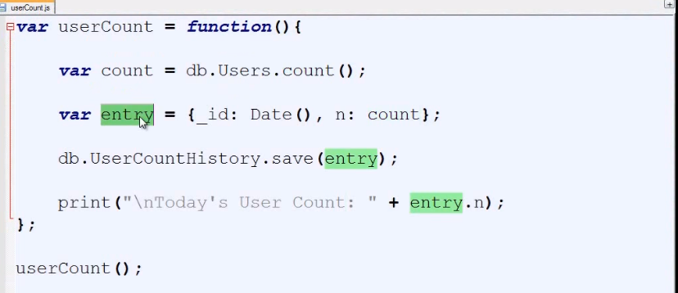

Slide 10
Getting Around
Quick ref - keystrokes
Key | Function
[⬅] [➔] | Move cursor right/left
[Ctrl] + [⬅], [Ctrl] +[➔] | Move cursor right/left
[⬆] [⬇] | Scroll history
[Home] or [Ctrl] + [A] | Start of line
[End] or [Ctrl] + [E] | End of line
[Ctrl] + [K] | Delete to end of line
[Ctrl] + [L] | Clear screen

Slide 11
External Editor
Complex scripts can use a “big-boy” editor
Wire up the shell to use your favorite editor
❶ // From the console:
C:\> set EDITOR=“mySuperEditor.exe”
❷ // From the shell: edit
mongo> myFunction = function(x){}
mongo> edit myFunction

Slide 12
Prevent Disaster
// sample .mongorc.js script
var _no_ = function(){ print("Nope!");}
DB.prototype.dropDatabase = _no_;
db.dropDatabase = db.prototype.dropDatabase;
DB.prototype.shutdownServer = _no_;
db.shutdownServer = db.prototype.shutdownServer;

Slide 13





Alternatives?
Command line benefits
Free
Comes with
Interactive
Scriptable
Makes you proficient

Slide 14
Summary
Use it Know it
Interactive
Run scripts
Tips & tricks
Shortcuts

